Slide 1
SQL
Select statement
Fundamentals of Database Systems

Slide 2
Syntax of Select
SELECT [ALL | DISTINCT]
{*| [column_expression [new_name]] [,...]}
FROM table_name [alias_table] [,...]
[WHERE podmienka]
[GROUP BY list of column names]
[HAVING podmienka]
[ORDER BY coulmn_name [ASC | DESC] [,...]
... All rows, or duplicity elimination
... All columns, or selected
... List of tables, views... , like sources of data
... Join conditions+ logical conditions
... Groupping rows
... Condition with aggregation functions
... Used with aggregatin functions
... Sorting under columns(ascending, descending)

Slide 3
Selection all
SELECT *
FROM os_udaje
#rod_cislo | meno | priezvisko | ulica | obec
801106/3456 | Stanislav | Ratroch | Juh 2100/456 | Kosice
790907/1259 | Branislav | Novak | Prievoznicka | Kosice
810514/5341 | Lukas | Kluciar | Tatranska 22 | Komarno
771124/3578 | Zdeno | Satrapa | Namestie SNP 15 | Plzen
795310/2145 | Erika | Lipovska | Orlove 16 | Bytca
796225/7452 | Erika | Slamova | Dolna 12 | B. Bystrica

Slide 4
Columns selection –
SELECT meno, priezvisko
FROM os_udaje
#rod_cislo | meno | priezvisko | ulica | obec
801106/3456 | Stanislav | Ratroch | Juh 2100/456 | Kosice
790907/1259 | Branislav | Novak | Prievoznicka | Kosice
810514/5341 | Lukas | Kluciar | Tatranska 22 | Komarno
771124/3578 | Zdeno | Satrapa | Namestie SNP 15 | Plzen
795310/2145 | Erika | Lipovska | Orlove 16 | Bytca
796225/7452 | Erika | Slamova | Dolna 12 | B. Bystrica

Slide 5
Selection of rows
SELECT *
FROM os_udaje
WHERE meno =‘Erika’
#rod_cislo | meno | priezvisko | ulica | obec
801106/3456 | Stanislav | Ratroch | Juh 2100/456 | Kosice
790907/1259 | Branislav | Novak | Prievoznicka | Kosice
810514/5341 | Lukas | Kluciar | Tatranska 22 | Komarno
771124/3578 | Zdeno | Satrapa | Namestie SNP 15 | Plzen
795310/2145 | Erika | Lipovska | Orlove 16 | Bytca
796225/7452 | Erika | Slamova | Dolna 12 | B. Bystrica

Slide 6
SELECT *
FROM os_udaje
meno, priezvisko
WHERE meno = ‘Erika’
#rod_cislo | meno | priezvisko | ulica | obec
801106/3456 | Stanislav | Ratroch | Juh 2100/456 | Kosice
790907/1259 | Branislav | Novak | Prievoznicka | Kosice
810514/5341 | Lukas | Kluciar | Tatranska 22 | Komarno
771124/3578 | Zdeno | Satrapa | Namestie SNP 15 | Plzen
795310/2145 | Erika | Lipovska | Orlove 16 | Bytca
796225/7452 | Erika | Slamova | Dolna 12 | B. Bystrica

Slide 7
Virtual columns renaming
SELECT os_cislo ,
cis_predmet predmet ,
vysledok AS znamka
FROM zap_predmety;
OS_CISLO | PREDMET | ZNAMKA
1448 | P111 | 1
1448 | P203 | 4
1559 | P203
1559 | P201
807 | P211 | 3
807 | P202 | 2
807 | P203 | 4

Slide 8
Virtual columns renaming
SELECT os_cislo ,
cis_predmet predmet ,
vysledok AS znamka
FROM zap_predmety
WHERE znamka = 1;
ZLE
SELECT os_cislo ,
cis_predmet predmet ,
vysledok AS znamka
FROM zap_predmety
WHERE vysledok =1;
OK

Slide 9
Duplicity elimination
SELECT DISTINCT meno, priezvisko FROM os_udaje
meno | priezvisko
Stanislav | Novak
Stanislav | Novak
Lukas | Peter
Zdeno | Kusy
Erika | Slamova
Erika | Budkova
meno | priezvisko
Stanislav | Novak
Lukas | Peter
Zdeno | Kusy
Erika | Slamova
Erika | Budkova
DISTINCT

Slide 10
More tables in the Select statement

Slide 11
Cartesian product
SELECT meno, vysledok FROM st, zp
ST |  |  |  | ZP
OC | Meno | Rocnik |  | OC | CP | Vysledok |  | Meno | Vysledok
1 | Erika | 2 |  | 1 | A602 | A |  | Erika | A
2 | Pavol | 3 |  | 1 | P101 | B |  | Erika | B
 |  |  |  | 2 | P102 | E |  | Erika | E
 |  |  |  | 2 | P201 | F |  | Erika | F
 |  |  |  | 2 | BN03 | E |  | Erika | E
 |  |  |  |  |  |  |  | Pavol | A
Card(st)=2; card(zp) = 5; |  |  |  | Card(out) = 10 |  |  |  | Pavol | B
Card(st) = 6000; card(zp)=150000; |  |  |  |  |  |  |  | Pavol | E
 |  |  |  | Card(out) = 900.000.000 |  |  |  | Pavol | F
 |  |  |  |  |  |  |  | Pavol | E

Slide 12
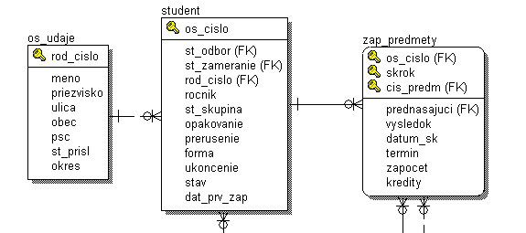
List of students names with courses results
SELECT meno, priezvisko
FROM os_udaje
, cis_predm, vysledok
, zap_predmety
, student
WHERE os_udaje.rod_cislo = student.rod_cislo
and student.os_cislo = zap_predmety.os_cislo

Slide 13
Functions
Standard
  Date
  Textual
  Numeric
  Special
  With operstors
User defined
  Made with statement CREATE FUNCTION
Agreggation
  Min, max, count, avg, sum

Slide 14
Standard function and operators
1 source row
Standard function,
operator
1 output row

Slide 15
Aggregation functions
More source rows
Aggregation function
1 output row

Slide 16
Standard functions, operators

Slide 17
Textuall functions
CONCAT(string1, string2)
Concatenation of strings . Equivalent is the || operator.
SUBSTR(string, m [,n])
returns substring.
INSTR(string,substring,[m[,n]])
Looking for n- appearance of substring in the string and returns position of the first character of the substring else returns 0.
LENGTH(string)
Returns length of the string.

Slide 18
Example
Concat (‘Peter’, ‘Novak’)
‘Peter’|| ‘Novak’
PeterNovak
Concat(Concat (‘Peter’, ‘ ’), ‘Novak’)
‘Peter’|| ‘ ’|| ‘Novak’
Peter Novak

Slide 19
Example(2)
Substr(‘5ZA31’,4,1) 3
Substr(‘5ZA31’,4,2) 31
instr(‘zajtra’,’a’, 1) 2
instr(‘zajtra’,’a’,2) 6
length(‘5ZA31’) 5

Slide 20
Example(3)
SELECT CONCAT(meno,priezvisko) FROM os_udaje
or
SELECT meno || priezvisko FROM os_udaje
meno || priezvisko
ErikaGrondzakova
IvanJanosik
StanislavaCsanyiova

Slide 21
Example(4)
SELECT meno, substr(priezvisko,1,10), substr(obec,1,8), psc
FROM os_udaje

Slide 22
Examle(5)
SELECT os_cislo,
SUBSTR(st_skupina, 2,1) pracovisko
FROM student
…………………………………………………
os_cislo pracovisko
Z
Z
Z

Slide 23
Example(6)
SELECT meno, priezvisko, LENGTH(meno)+LENGTH(priezvisko)
FROM os_udaje
WHERE LENGTH(priezvisko)=LENGTH(meno)
………………………………………………….
meno priezvisko (expression)
Alfonz Kratky 12

Slide 24
Example(7)
CREATE TABLE pom
AS
SELECT meno || ‘ ‘ || priezvisko cele_meno
FROM os_udaje;

Slide 25
Example(8)
SELECT
SUBSTR( cele_meno, 1, INSTR (cele_meno, ‘ ‘,-1)) meno ,
SUBSTR( cele_meno, INSTR (cele_meno, ‘ ‘,-1)) priezvisko
FROM pom;
…………………………………………..
meno priezvisko
Csaba Molnar
Ivana Maria Rajtarova
Slavomir Kopinec

Slide 26
Example(9)
SELECT
SUBSTR( cele_meno, 1, INSTR (cele_meno, ‘ ‘)) meno ,
SUBSTR( cele_meno, INSTR (cele_meno, ‘ ‘)) priezvisko
FROM pom;
…………………………………………..
meno priezvisko
Csaba Molnar
Ivana Maria Rajtarova
Slavomir Kopinec

Slide 27
Numerical functions
ABS(expression)
returns absolute value of the expression.
ROUND(n [,m])
the round function returns a number n rounded to a m number of decimal places. If this parameter is omitted, the round function will round the number to 0 decimal places.
TRUNC(n [,m])
the trunc function returns number n truncated to a specific to m number of decimal places. If this parameter is omitted, the trunc function will truncate the number to 0 decimal places.

Slide 28
Example
Abs(124) 124
Abs (-124) 124
round(164.16666,2) 164.17
trunc(164.16666,2) 164.16
round(164.6666,-2) 200
trunc(164.6666,-2) 100
round(164.6666) 165
trunc(164.6666) 164

Slide 29
Example(2)
SELECT ABS(124) ABS1, ABS(-124) ABS2
FROM dual;
ABS1 ABS2
124 124
Comment:
dual is a table which is created by oracle. It consists of exactly one column whose name is dummy and has only one record. The value of that record is X.

Slide 30
Date functions
SYSDATE
Returns actual date and time.
TRUNC(d [, format])
function returns a date truncated to a specific unit of measure. format is the unit of measure to apply for truncating. If the format parameter is omitted, the trunc function will truncate the date to the day value, so that any hours, minutes, or seconds will be truncated off.
TO_CHAR(d, [format [, nls_param] ])
the to_char function converts a number or date to a string.
format is optional. This is the format that will be used to convert value to a string.
nls_language is optional. This is the nls language used to convert value to a string.
TO_DATE(string, [format [, nls_param]])
the to_date function converts a string to a date..

Slide 31
Format string
Skratka
Význam
DD
Deň v mesiaci (01 až 31)
Day
Deň v týždni, prvé písmeno je veľké (napr. Saturday)
MM
Mesiac (01 až 12)
Month
Názov mesiaca, prvé písmeno je veľké
MON
Prvé tri písmena z názvu mesiaca veľkými písmenami
YY
Rok (00 až 99)
YYYY
Rok (vrátane storočia, napr. 1999, alebo 1901)
RR
Rok (00 až 99)
RRRR
Rok (vrátane storočí, napr. 1999, alebo 2001)
MI
Minúta (00 až 60)
HH
Hodina (01 až 12)
HH24
Hodina (00 až 23)
SS
Sekunda (00 až 59)
To_char(sysdate,’DD.MM.RRRR’) ==> 12.03.2007

Slide 32
Example
Select
TO_DATE(trunc(sysdate,'DD'))– to_date('01.03.2007','DD.MM.RRRR') A,
TO_CHAR(SYSDATE,‘DD.MM.RRRR‘) B
from dual;
A B
11 12.03.2007

Slide 33
Work with undefined values
NVL(výraz1, výraz2)
If výraz1 is null, returns výraz2, else returns výraz1.
In the condition:
stĺpec IS NULL
stĺpec IS NOT NULL

Slide 34
Example
SELECT nvl(vysledok,4)
FROM zap_predmety

Slide 35
Special functions
DECODE(n , if1, then1, if2, then2,…[,else])
the decode function has the functionality of an IF-THEN-ELSE statement.
USER
the user function returns the user_id from the current Oracle session..
ROWID
A rowid is pseudoculmn, that uniquely identifies a row within a table, but not within a database.

Slide 36
Example
select meno, priezvisko,
decode (substr(rod_cislo,3,1),5,'zena',6,'zena','muz') pohlavie
from os_udaje
meno priezvisko pohlavie
Lubos Lehotsky muz
Rudolf Kovac muz
Zuzana Slamova zena
Erika Lipovska zena

Slide 37
Using functions in the select
creation virtual column using the function
  Standard function
    Select substr(st_skupina,2,1) as pracovisko FROM ...
  Aritmetic operations
    Select (4-vysledok)*ects as body FROM ...
  Constatnts
    Select 2006 as skrok FROM ...
Using function in the condition
  Select * from os_udaje
  where substr(rod_cislo,3,1) between 5 and 6;

Slide 38
Example
SELECT (3+5)*2/(10-5) FROM DUAL;
(3+5)*2/(10-5)
3.2

Slide 39
Conditions
Relational operators: =, <, >, <>, !=
Interval: BETWEEN
Sets operators: IN, NOT IN, EXISTS, NOT EXISTS
Textual operator: LIKE
Null values: IS NULL, IS NOT NULL

Slide 40
Relational operators
=
column < column
Function (parameters) > Function(parameters)
constatnt <> constant
!=

Slide 41
Interval
SELECT * FROM student
WHERE rocnik >= 3
AND rocnik <= 5;
SELECT * FROM student
WHERE rocnik BETWEEN 3 AND 5;

Slide 42
Set operators
column IN (list of values)
value NOT IN (select-statement)
function
EXISTS (list of values)
NOT EXISTS (select-statement)

Slide 43
Textuall operator LIKE
‘%‘ ... Any character
‘_‘ ... Only one character
{coulmn|value|function} LIKE ‘%‘
... Free defined value
meno LIKE ‘M%‘ ... Started with M
st_skupina LIKE ‘5ZA3_‘ ... Aplic. Inf. 3.year

Slide 44
MATCHES
* free number of charaters
? Only one character
[ ] enumerated characters

Slide 45
MATCHES
SELECT meno, priezvisko
FROM os_udaje
WHERE meno="Stanislav"
alebo
SELECT meno, priezvisko
FROM os_udaje
WHERE meno MATCHES "Stanislav"
alebo
SELECT meno, priezvisko
FROM os_udaje
WHERE meno LIKE "Stanislav"

Slide 46
Null hodnoty
column IS NULL
function(parameters) IS NOT NULL

Slide 47
More conditions
AND, OR, ()
SELECT * FROM os_udaje
WHERE (meno LIKE ‘M%’
OR meno LIKE ‘K%’)
AND substr(rod_cislo, 3,1) IN (‘5’,’6’)

Slide 48
Work with temporary table
CREATE TABLE docasna
AS
SELECT * FROM os_udaje
WHERE meno=‘Stanislav‘

Slide 49
Aggregation functions
Min – minimum of values
Max – maximum of values
Avg – average of values
Count – number of rows
Sum – suma of values

Slide 50
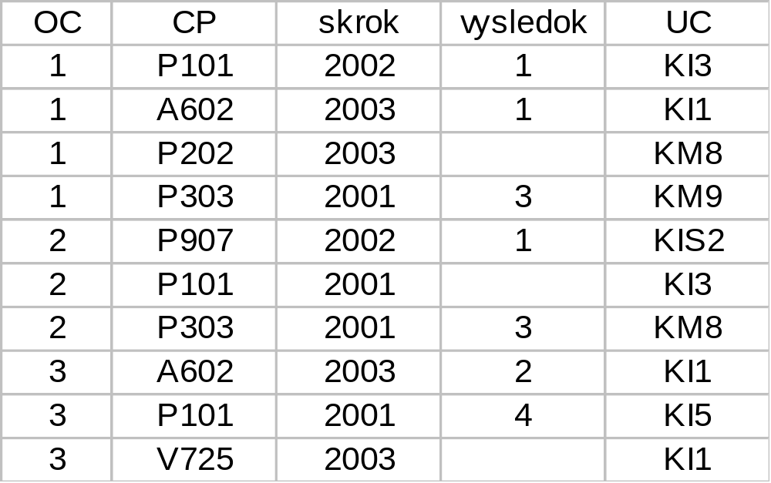
SELECT count(*) FROM zap_predmety
10

Slide 51
SELECT oc, count(*) FROM zap_predmety
GROUP BY oc
1 4
3
3 3

Slide 52
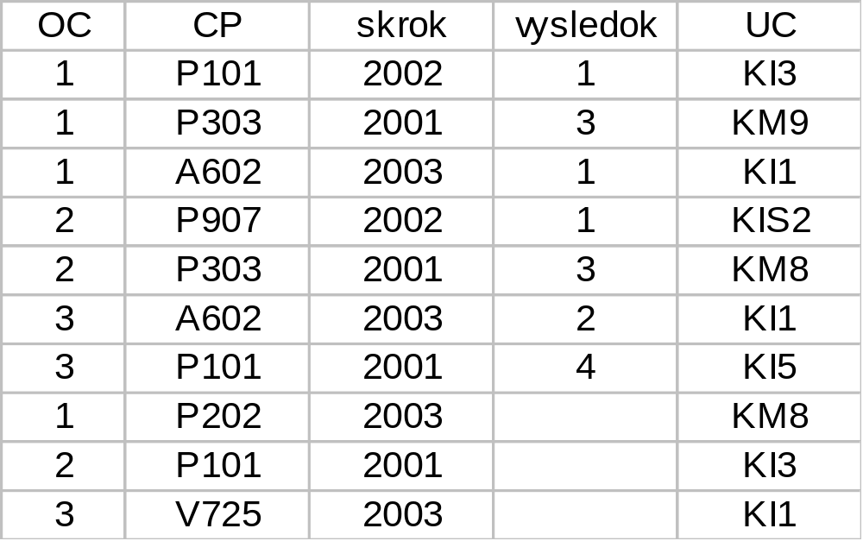
SELECT oc, count(vysledok) FROM zap_predmety
GROUP BY oc
1 3
2
3 2

Slide 53
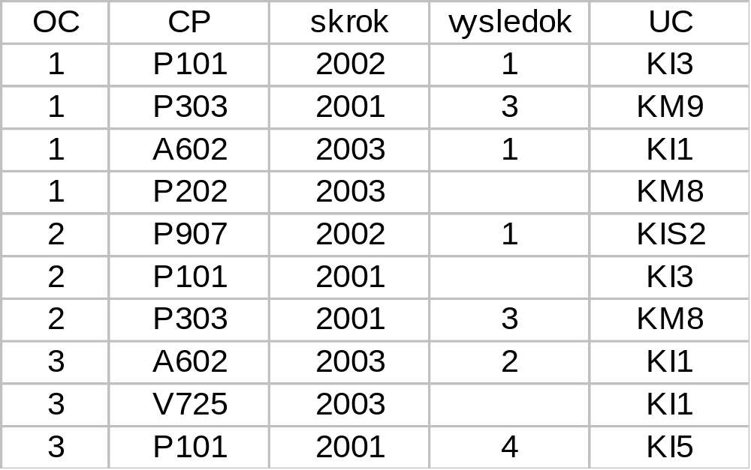
SELECT oc, skrok, count(*) FROM zap_predmety
GROUP BY oc, skrok
1 | 2002 | 1
1 | 2001 | 1
1 | 2003 | 2
2 | 2002 | 1
2 | 2001 | 2
3 | 2003 | 2
3 | 2001 | 1

Slide 54
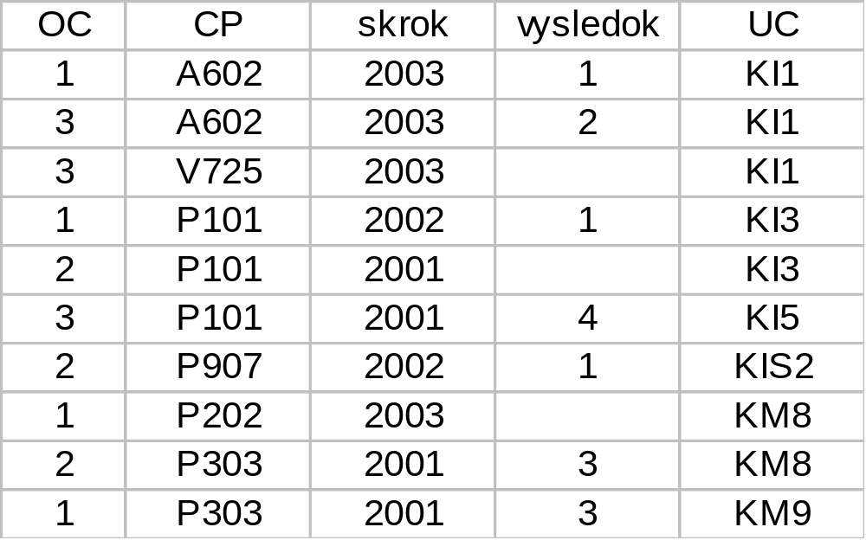
SELECT count(*) FROM zap_predmety
GROUP BY uc
3
2
1
1
2
1

Slide 55
SELECT meno, priezvisko, count(*) FROM pom
GROUP BY meno, priezvisko
Ján Malý 6
Peter Novák 4
SELECT meno, priezvisko, count(*) FROM pom
GROUP BY meno, priezvisko, oc
Ján Malý 4
Ján Malý 2
Peter Novák 4
#OC
MENO
PRIEZV
VYSLEDOK
1
Ján
Malý
2
1
Ján
Malý
2
1
Ján
Malý
2
1
Ján
Malý
1
2
Ján
Malý
1
2
Ján
Malý
1
3
Peter
Novák
2
3
Peter
Novák
2
3
Peter
Novák
1
3
Peter
Novák
2

Slide 56
Sorting

Slide 57
Sorting
SELECT meno, priezvisko
FROM os_udaje
ORDER BY priezvisko

Slide 58
Sorting
SELECT meno, priezvisko
FROM os_udaje
ORDER BY priezvisko, meno

Slide 59
Sorting
SELECT meno, priezvisko
FROM os_udaje
ORDER BY 2, 1

Slide 60
Sorting
SELECT meno, priezvisko
FROM os_udaje
ORDER BY priezvisko ASC , meno DESC

Slide 61
Sorting
SELECT os_cislo, cis_predmet,zapocet,datum_sk, datum_sk-zapocet rozdiel
FROM zap_predmety order by rozdiel

Slide 62
Embeded queries or subqueries

Slide 63
Subquery - IN
SELECT NAZOV FROM PREDMET
WHERE CIS_PREDMET IN
(SELECT DISTINCT CIS_PREDMET FROM ZAP_PREDMETY)

Slide 64
ANY
SELECT NAZOV FROM PREDMET
WHERE CIS_PREDMET = ANY
(SELECT DISTINCT CIS_PREDMET FROM ZAP_PREDMETY)

Slide 65
subquery - SOME
SELECT NAZOV FROM PREDMET
WHERE CIS_PREDMET = SOME
(SELECT DISTINCT CIS_PREDMET FROM ZAP_PREDMETY)

Slide 66
Subquery
SELECT NAZOV FROM PREDMET
WHERE CIS_PREDMET NOT IN
(SELECT DISTINCT CIS_PREDMET FROM ZAP_PREDMETY)

Slide 67
Subquery
SELECT NAZOV FROM PREDMET
WHERE EXISTS
(SELECT ’X‘ FROM ZAP_PREDMETY
WHERE
ZAP_PREDMETY.CIS_PREDMET = PREDMET.CIS_PREDMET
)

Slide 68
subquery
SELECT NAZOV FROM PREDMET
WHERE NOT EXISTS
(SELECT ’X‘ FROM ZAP_PREDMETY
WHERE
ZAP_PREDMETY.CIS_PREDMET = PREDMET.CIS_PREDMET
)

Slide 69
Corelated subqueries
Výber študentov, pri ktorých aspoň dvaja majú zapísaný daný predmet
SELECT A.OS_CISLO, A.CIS_PREDMET
FROM ZAP_PREDMETY A
WHERE A.VYSLEDOK IS NOT NULL AND
2 < (SELECT COUNT(*)
FROM ZAP_PREDMETY B
WHERE A.OS_CISLO <> B.OS_CISLO AND
A.CIS_PREDMET=B.CIS_PREDMET)

Slide 70
Subquery
Find the oldest person - Výber najstaršieho zamestnanca
SELECT ROD_CISLO
FROM OSOBA
WHERE DAT_NAR <= ALL (SELECT DAT_NAR FROM OSOBA)

Slide 71
Work with more tables

Slide 72
Cartesian product and projection
SELECT meno, vysledok
FROM st, zp
ST |  |  |  | ZP
OC | Meno | Rocnik |  | OC | CP | Vysledok |  | Meno | Vysledok
1 | Erika | 2 |  | 1 | A602 | A |  | Erika | A
2 | Pavol | 3 |  | 1 | P101 | B |  | Erika | B
 |  |  |  | 2 | P102 | E |  | Erika | E
 |  |  |  | 2 | P201 | F |  | Erika | F
 |  |  |  | 2 | BN03 | E |  | Erika | E
 |  |  |  |  |  |  |  | Pavol | A
Card(st)=2; card(zp) = 5; |  |  |  | Card(out) = 10 |  |  |  | Pavol | B
Card(st) = 6000; |  |  |  |  |  |  |  | Pavol | E
card(zp)= 150000 |  |  |  | Card(out) = 900.000.000 |  |  |  | Pavol | F
 |  |  |  |  |  |  |  | Pavol | E

Slide 73
Basic JOIN
SELECT ...
FROM list of tables
WHERE conditions for connection;

Slide 74
List of student with results
SELECT meno, priezvisko
FROM os_udaje
, cis_predm, vysledok
, zap_predmety
, student
WHERE os_udaje.rod_cislo = student.rod_cislo
and student.os_cislo = zap_predmety.os_cislo

Slide 75
SELECT meno, priezvisko, cis_predm, vysledok
FROM os_udaje ou, student st, zap_predmety zp
WHERE ou.rod_cislo = st.rod_cislo
AND st.os_cislo = zp.os_cislo
SELECT meno, priezvisko, cis_predm, vysledok
FROM os_udaje JOIN student USING (rod_cislo)
JOIN zap_predmety USING (os_cislo)
… must be with the same name in joining tables
SELECT meno, priezvisko, cis_predm, vysledok
FROM os_udaje ou JOIN student st
ON (ou.rod_cislo = st.rod_cislo)
JOIN zap_predmety zp
ON (st.os_cislo = zp.os_cislo)
… always possible

Slide 76
Syntax (ANSI )
SELECT ...
FROM ...,tabulka1 [NATURAL] JOIN_TYPE JOIN tabulka2
{ |ON (podmienka_spojenia)| USING (zoznam_stlpcov)}, ...
[WHERE ...]

Slide 77


UNIVERSITY OF ZILINA
FACULTY OF MANAGEMENT SCIENCE AND INFORMATICS
DEPARTMENT OF INFORMATICS
Univerzitna 8215/1SK-01026, Zilina, Slovak Republic
Phone: +421-41-513 4040
Fax: +421-41-513 4055
Homepage: http://www.fri.uniza.sk
Introduction
The Department of Informatics comprises around 20 academics and research fellows who form research community in Computer Science. Its complement of people directly involved in research is close to 50. The Department is strongly involved in many practical collaborative industry projects and research projects on national and international level.
Research
Research addresses the fundamentals of computer systems, architectures, database systems and information analysis. The key research topics cover distributed and parallel systems and advanced database systems.
prof. Ing. Karol Matiaško, PhD.
Karol.matiasko@fri.uniza.sk
Department of Informatics
Faculty of Management Science and Informatics
University of Zilina

Slide 78
Join_Type
INNER – internal join i.e. only joined rows . This kind of join is DEFAULT.
RIGHT [OUTER]- right external join i.e. result will have connected rows and rows from right table if join was not realized.
LEFT [OUTER]- left external join i.e. result will have connected rows and rows from left table if join was not realized.
FULL [OUTER] – complete external join i.e. result will have connected rows and rows from right table if join was not realized and rows from left table if join was not realized.
NATURAL – in this case is not possible use ON (condition), or USING clause, because the join will be done under the equivalent name column in joining tables.Referencing integrity is not checking.
USING (list of columns)– if we use USING, then is not possible use NATURAL either ON (condition) clause. List of columns must exists in both tables. Referencing integrity is not checking.

Slide 79
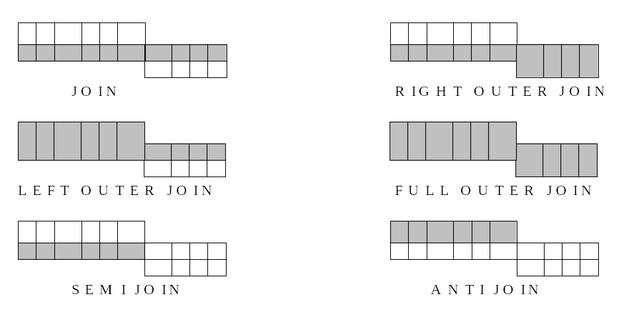
Kinds of joins

Slide 80
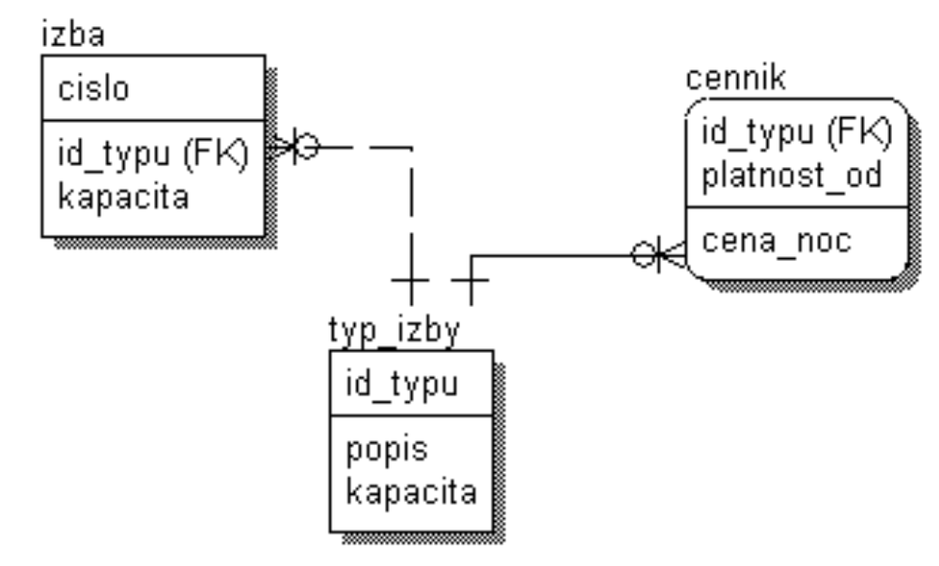
ODD join
Select cena_noc
from izba i, typ_izby t, cennik c
where i.id_typu = t.id_typu
and t.id_typu = c.id_typu
and i.cislo = 212
and c.platnost_od = '1.6.2006';

Slide 81
More Simple Notation
Select cena_noc
from izba i, cennik c
where i.id_typu = c.id_typu
and i.cislo = 212
and c.platnost_od = '1.6.2006';

Slide 82
JOIN
SELECT meno, priezvisko, popis, kontakt
FROM os_udaje ou, kontakty kont
WHERE ou.rod_cislo = kont.rod_cislo
SELECT meno, priezvisko, popis, kontakt
FROM os_udaje ou INNER JOIN kontakty kont
ON (ou.rod_cislo = kont.rod_cislo);
-- len ak atributy spojenia maju rovnake meno
–- zle ak aj ine atributy maju rovnake meno, nielen atributy spojenia
SELECT meno, priezvisko, popis, kontakt
FROM os_udaje ou NATURAL JOIN kontakty kont;
-- len ak atributy spojenia maju rovnake meno
SELECT meno, priezvisko, popis, kontakt
FROM os_udaje ou JOIN kontakty kont USING (rod_cislo);

Slide 83
LEFT OUTER JOIN
SELECT meno, priezvisko, popis, kontakt
FROM os_udaje ou LEFT OUTER JOIN kontakty kont
ON (ou.rod_cislo = kont.rod_cislo)
ORDER BY priezvisko;
–- slovo "outer" je mozne vynechat

Slide 84
LEFT OUTER JOIN
SELECT meno, priezvisko, popis, kontakt
FROM os_udaje ou LEFT JOIN kontakty kont
ON (ou.rod_cislo = kont.rod_cislo)
ORDER BY priezvisko;

Slide 85
MENO | PRIEZVISKO | POPIS | KONTAKT
Branislav | Balaz
Bohuslav | Biely
Marek | Durica
Andrej | Janci
Peter | Kapustny | email | kapo@post.sk
Martin | Kluciar
Rastislav | Kontros
Rudolf | Kovac
Jan | Krnac
Lubos | Lehotsky
Erika | Lipovska
Frantisek | Murgas
Peter | Novak | telef | 041/5698574
Peter | Novak | email | Peter.Novak@st.fri.utc.sk
Juraj | Papun
Marek | Ratroch | telef | 07/5561174
Lukas | Satrapa | email | lsatra@post.sk
Lukas | Satrapa | mobil | 0915 1234222
Zuzana | Slamova
Stanislav | Steinmuller
Zdeno | Svetkovsky
Janos | Toth

Slide 86
RIGHT OUTER JOIN
SELECT meno, priezvisko, popis, kontakt
FROM os_udaje ou RIGHT OUTER JOIN kontakty kont
ON (ou.rod_cislo = kont.rod_cislo)
ORDER BY priezvisko;

Slide 87
RIGHT OUTER JOIN
SELECT meno, priezvisko, popis,kontakt
FROM kontakty kont RIGHT OUTER JOIN os_udaje ou
ON (ou.rod_cislo = kont.rod_cislo)
ORDER BY priezvisko;

Slide 88
RIGHT OUTER JOIN
SELECT meno, priezvisko, popis,kontakt
FROM kontakty kont NATURAL RIGHT OUTER JOIN os_udaje ou
ORDER BY priezvisko;

Slide 89
RIGHT OUTER JOIN
SELECT meno, priezvisko, popis,kontakt
FROM kontakty kont RIGHT OUTER JOIN os_udaje ou USING (rod_cislo)
ORDER BY priezvisko;

Slide 90
OUTER JOIN
-- older syntax
SELECT meno, priezvisko, popis,kontakt
FROM kontakty kont, os_udaje ou
WHERE ou.rod_cislo (+) = kont.rod_cislo
ORDER BY priezvisko;

Slide 91
OUTER JOIN
-- older syntax
SELECT meno, priezvisko, popis,kontakt
FROM kontakty kont, os_udaje ou
WHERE ou.rod_cislo = kont.rod_cislo (+)
ORDER BY priezvisko;

Slide 92
FULL OUTER JOIN
SELECT meno, priezvisko, popis,kontakt
FROM kontakty kont FULL OUTER JOIN os_udaje ou
ON ( ou.rod_cislo = kont.rod_cislo )
ORDER BY priezvisko;

Slide 93
FULL OUTER JOIN
SELECT meno, priezvisko, popis,kontakt
FROM kontakty kont NATURAL FULL OUTER JOIN os_udaje ou
ORDER BY priezvisko;

Slide 94
FULL OUTER JOIN
FROM kontakty kont FULL OUTER JOIN os_udaje ou USING (rod_cislo)
ORDER by priezvisko;
–-

Slide 95
FULL OUTER JOIN
–- pomocou starej syntaxe to bolo mozne len cez UNION dvoch selectov
SELECT meno, priezvisko, popis,kontakt
FROM kontakty kont, os_udaje ou
WHERE kont.rod_cislo (+) = ou.rod_cislo
UNION
SELECT meno, priezvisko, popis,kontakt
FROM kontakty kont, os_udaje ou
WHERE kont.rod_cislo = ou.rod_cislo(+)
ORDER BY priezvisko;

Slide 96
SEMI JOIN
SELECT ou.*
FROM os_udaje ou
WHERE EXISTS( SELECT 'x'
FROM kontakty kont
WHERE kont.rod_cislo = ou.rod_cislo);

Slide 97
ANTI JOIN
SELECT ou.*
FROM os_udaje ou
WHERE NOT EXISTS( SELECT 'x'
FROM kontakty kont
WHERE kont.rod_cislo = ou.rod_cislo);

Slide 98
Steps for complicated tasks with join
We want to create List of students (name, surname) who studied Course A602

